Slide 1
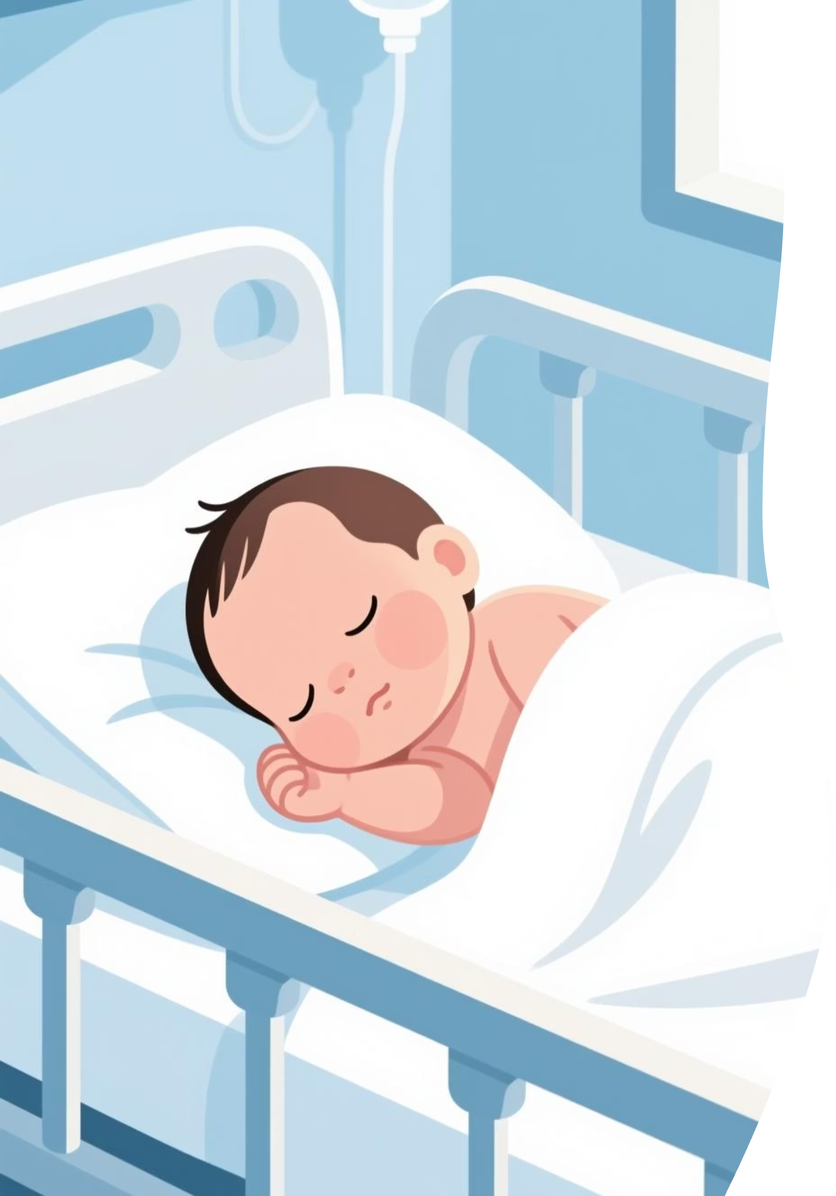

TinyVitals
AI-Powered Newborn Health Screening from a Simple Photo

Slide 2

The Challenge We're Solving
Limited Access
Critical Window
Resource Gap
Rural healthcare facilities often lack specialized pediatric diagnostic equipment and trained specialists for early newborn screening.
The first days of life are crucial. Early detection of conditions like jaundice can prevent serious complications and save lives.
Many health workers in low-resource settings need accessible tools to support clinical decision-making for newborn care.

Slide 3



Our Solution: Accessible AI Screening
Simple Photo Upload
AI-Powered Analysis
Clear Results
Healthcare workers or parents capture a photo using any smartphone camera through our web interface.
Advanced machine learning models analyze visible health indicators in seconds with medical-grade accuracy.
Instant diagnosis with confidence scores, plain-language explanations, and actionable next steps for care.

Slide 4





How TinyVitals Works
Upload Image
User uploads baby photo through React web interface
Preprocessing
FastAPI backend standardizes and prepares image data
ML Classification
MobileNetV2 analyzes health indicators
AI Explanation
Gemini generates clear medical guidance
Results Display
Diagnosis with confidence score and advice

Slide 5





Technical Architecture
Frontend
Backend
React-based web application providing intuitive user interface accessible from any device with a browser.
FastAPI handles requests, image preprocessing with Pillow/OpenCV, and coordinates ML model inference.
AI Engine
AI Assistant
TensorFlow with MobileNetV2 transfer learning for efficient, accurate health condition classification.
Google Gemini API generates plain-language medical explanations and personalized care recommendations.

Slide 6
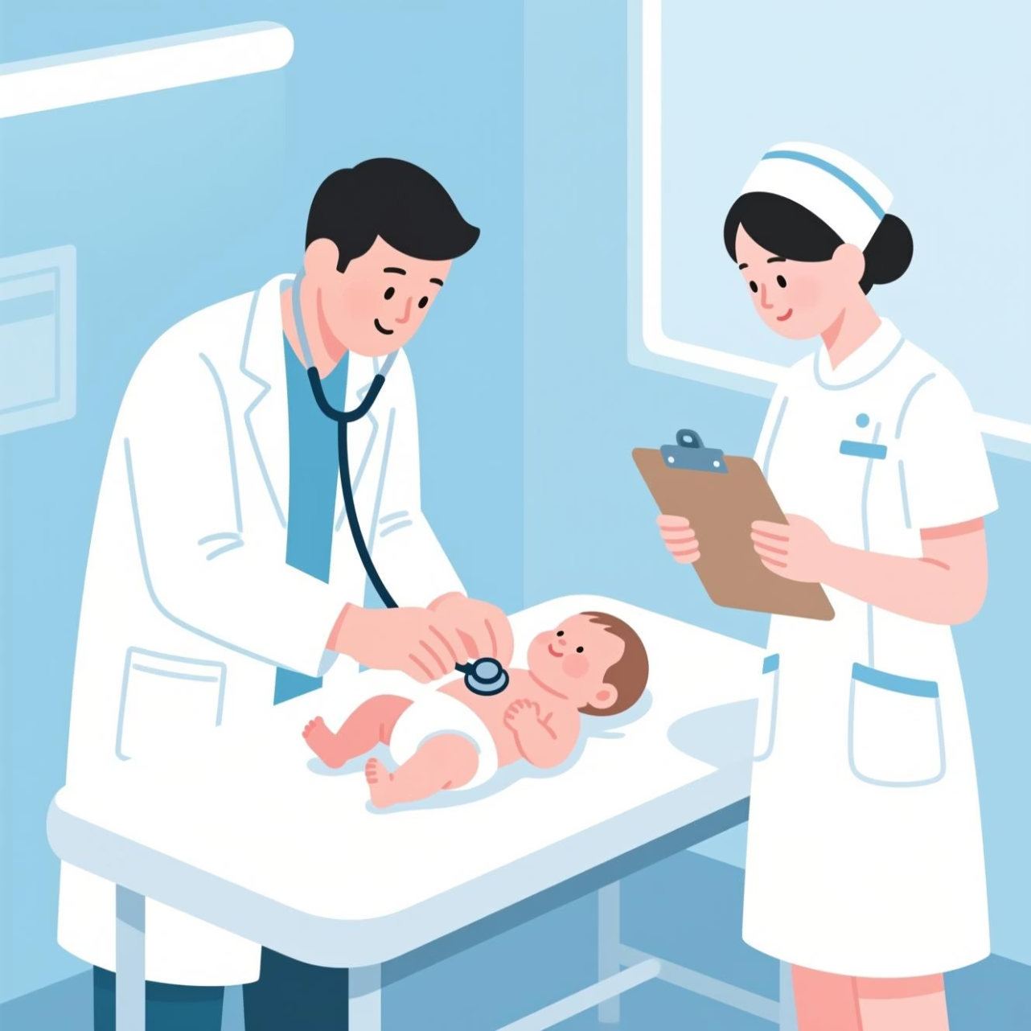
Core Detection Capabilities
Jaundice Detection
Health Assessment
Identifies yellowing of skin and eyes indicating elevated bilirubin levels requiring immediate attention.
Evaluates overall newborn wellness indicators including skin tone, alertness, and visible distress signs.
Confidence Scoring
Provides percentage-based confidence metrics to help healthcare workers prioritize cases and make informed decisions.

Slide 7




Why Our Approach Works
Fast Inference
Device Accessible
MobileNetV2 architecture delivers results in under 3 seconds, enabling real-time screening during clinical visits.
Web-based platform works on smartphones, tablets, and computers without requiring app installation or high-end hardware.
Google ML Ecosystem
Lightweight System
Leverages TensorFlow's proven reliability and Gemini's advanced language understanding for medical communication.
Optimized for low-bandwidth environments with efficient model size and minimal data transfer requirements.

Slide 8
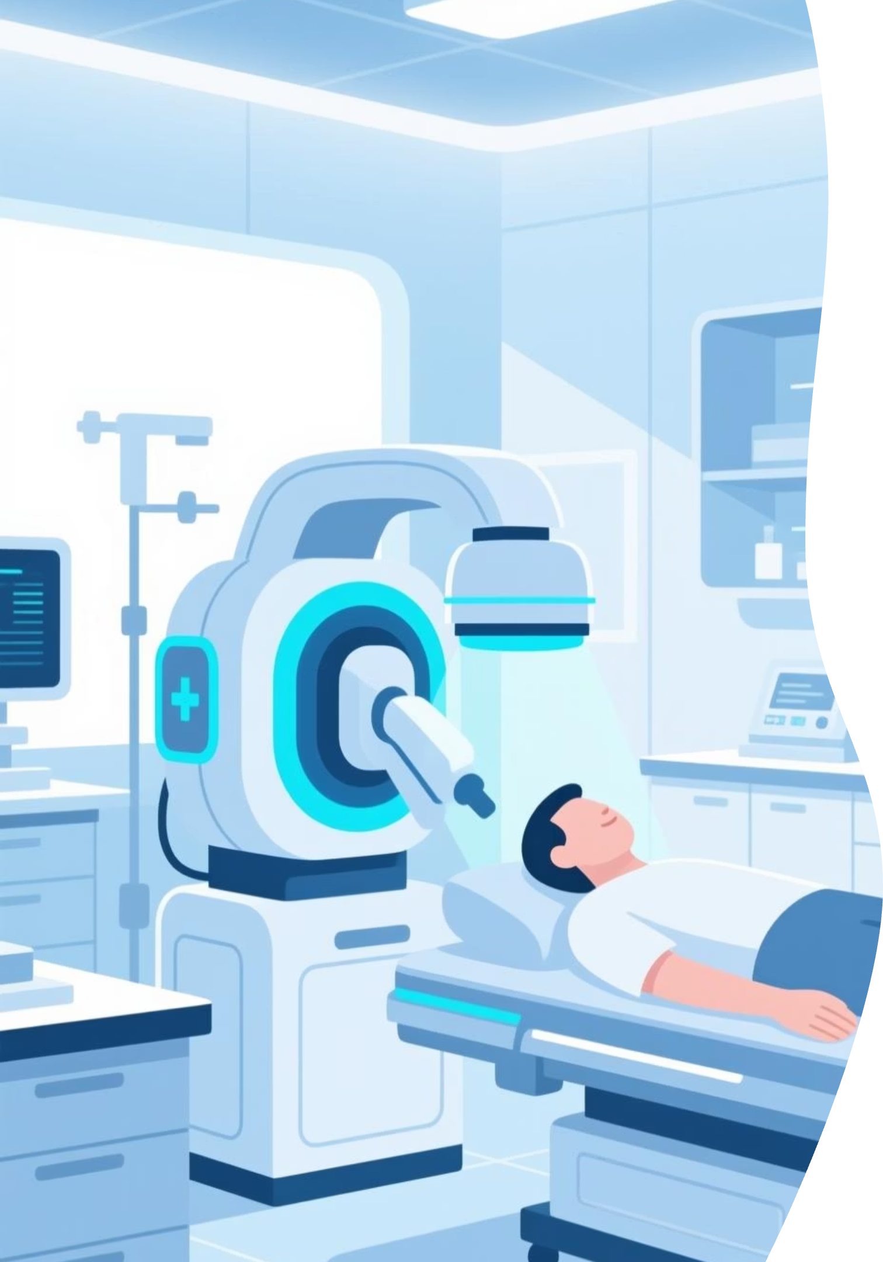
Future Roadmap
1
Expanded Detection
Add malnutrition, skin infections, and respiratory distress pattern recognition.
2
Offline Mode
TensorFlow Lite integration for areas with limited internet connectivity.
3
Multilingual Support
Local language guidance for diverse communities and health workers.
4
Trend Analytics
Longitudinal health data tracking to monitor infant development patterns.

Slide 9
Real-World Impact
75%
3sec
$0
Rural Coverage
Analysis Time
Equipment Cost
Percentage of underserved areas that could benefit from accessible newborn screening tools
Average time from photo upload to receiving actionable health insights
No specialized hardware required beyond existing smartphones
TinyVitals empowers healthcare workers with AI-assisted decision support, improves parental awareness of critical health signs, and helps reduce preventable neonatal complications through early detection.

Slide 10

TinyVitals
Making Newborn Healthcare More Accessible
Early detection saves lives. Technology makes it possible.
Thank you

